Slide 1
Hemodynamic monitoring parsimony: minimal information for rapid hemorrhage detection
Anthony Wertz, MS¹
Gilles Clermont, MD² ~ Artur Dubrawski, PhD, MEng¹
Michael R. Pinsky, MD, MCCM²
1. Auton Lab, Robotics Institute, Carnegie Mellon University
2. School of Medicine, University of Pittsburgh
Pittsburgh, PA, USA
Notes:
I would like to thank the Society for the opportunity to present our work here today, and I want to thank my coauthors as well.

Slide 2
Disclosures
Funding: NIH R01NR013912 (Don’t know)
No commercial conflict of interest
Notes:
We acknowledge our grants funding from the NIH and have no commercial conflicts of interest.

Slide 3
Motivation
We know: Vital sign (VS) collected from invasive and non-invasive sensors can be used to detect onset of hemorrhage in porcine models with performance dependent on the granularity of data used and the presence or absence of an individual baseline. (Wertz et al.)
We asked: How does the availability of sensing modalities affect performance?
Hypothesis:
Models using fewer and even completely non-invasive sensing modalities can still detect hemorrhage, albeit with a degradation in performance.
Why evaluate on less rich sensing modalities?
The previous models utilized central venous (CVC), pulmonary artery (PAC), and arterial (ART) catheters together, but rarely will a patient have all three.
How does performance degrade when sensors are removed?
Ideally a patient would have no invasive sensors at all to minimize risk of infection or other complications.
How well can we detect bleed when only non-invasive sensors are used?
Notes:
We know we can detect bleed in pig models and that that performance depends on the available data granularity (do we have waveform data, beat-to-beat metrics, or worse); and the availability of a pre-bleed stable baseline for comparison.
What we don’t know is how the availability of different sensing modalities affects performance. We hypothesize that, down to the level of non-invasive measurements only, we’ll still be able to detect bleed, but performance will be degraded as we remove richer data.

Slide 4
Motivation
We know: Vital sign (VS) collected from invasive and non-invasive sensors can be used to detect onset of hemorrhage in porcine models with performance dependent on the granularity of data used and the presence or absence of an individual baseline. (Wertz et al.)
We asked: How does the availability of sensing modalities affect performance?
Hypothesis:
Models using fewer and even completely non-invasive sensing modalities can still detect hemorrhage, albeit with a degradation in performance.
Why evaluate on less rich sensing modalities?
The previous models utilized central venous (CVC), pulmonary artery (PAC), and arterial (ART) catheters together, but rarely will a patient have all three.
How does performance degrade when sensors are removed?
Ideally a patient would have no invasive sensors at all to minimize risk of infection or other complications.
How well can we detect bleed when only non-invasive sensors are used?
Notes:
We’re interested in this because our original findings relied on the availability of central venous, pulmonary artery, and arterial catheters all being present, which is unrealistic. So how well can we predict bleed when we start removing catheters? And can we still predict bleed when invasive sensors are removed completely? These are the questions we wanted to address.

Slide 5

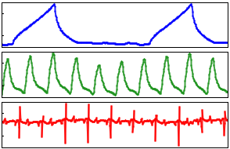
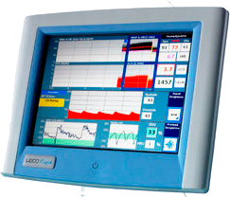
Dataset Collected from Porcine Models
Pigs were anesthetized and sensors connected for data collection, including:
Vital sensor data (arterial, central venous, and pulmonary artery pressures, ECG, plethysmograph, SpO₂, SvO₂) at 250Hz.
Beat-to-beat data from LiDCO device.
They were left to rest for 30 minutes while baseline data was collected.
The pigs were then bled at a constant rate:
20mL/min until mean arterial pressure dropped below 30mmHg.
Waveform
Beat-to-Beat
Notes:
In brief, the dataset we’re working with comes from pig models of hemorrhage. 38 Yorkshire pigs were anesthetized and then monitored using various sensing modalities, both invasive and non-invasive. They were observed for a period of 30 minutes, which we refer to as the stable baseline period. This is meant to establish a baseline for each pig’s individual physiology. Then, the pigs are bled at a constant rate of 20 mL/min until they reach a mean arterial pressure of 30 mmHg. Waveform data is collected at 250Hz throughout this process, and a LiDCO monitor is used to derive beat-to-beat metrics such as heart rate variability and cardiac output.

Slide 6
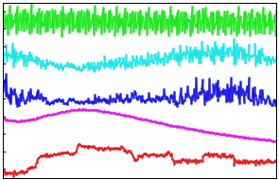

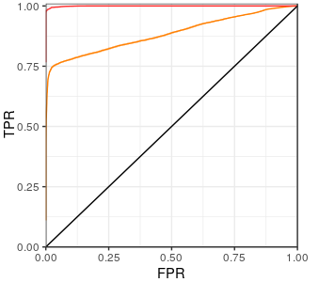
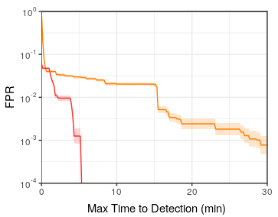
Computational Experimental Design
The data is featurized and those features are split into different (though not mutually exclusive) groups.
Those feature sets are used to validate random forest models that classify a pig as bleeding or not in a leave-one-pig-out cross validation framework.
The detection results are evaluated by means of Receiver Operator Characteristic (ROC) and Activity Monitoring Operator Characteristic (AMOC) curves.
Training Set
Testing Set
ROC
AMOC
Notes:
Modeling, at a high level, consists of three stages:
First, the data is featurized and split into groups based on modality, granularity, and availability of an individual baseline to test the effects of diminishing sensor availability.
Second, models are validated through cross-validation, explained next.
And finally, models are compared and evaluated through the use of receiver operator characteristic (or ROC) curves and activity monitoring operator characteristic curves (AMOCs). We’ll discuss both of these later.

Slide 7
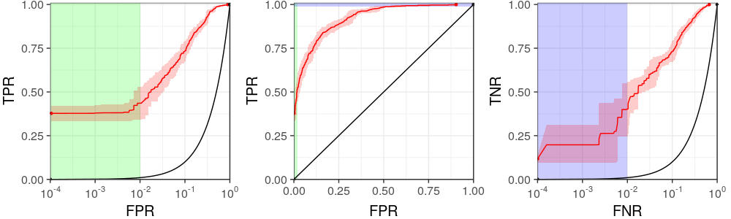
Models Validated using Cross Validation
Models evaluated in a leave-one-pig-out cross validation framework.
Random forest models trained (Auton Lab variant).
Handles missing values.
Builds explainable models.
Supports non-linear decision boundaries.
Successfully used in many other similar projects.
Performance compared using receiver operator characteristic (ROC) curves.
Training Set
Testing Set
Notes:
The models are evaluated in a leave-one-pig-out cross validation framework. That means we hold one pig’s data out as the testing set, train a model on all the remaining pigs, then evaluate that model on only the pig we removed. We do this for each pig, 38 times in total.

Slide 8
Random Forest Models Validated using Cross Validation
Models evaluated in a leave-one-pig-out cross validation framework.
Random forest models trained (Auton Lab variant).
Handles missing values.
Builds explainable models.
Supports non-linear decision boundaries.
Successfully used in many other similar projects.
Performance compared using receiver operator characteristic (ROC) curves.
Training Set
Testing Set
Notes:
The models trained are random forest classifiers to distinguish bleeding from not-bleeding. There are many reasons we chose this model, but importantly Wertz et al. have already shown good results on this task in the previous work on data granularity and normalization.

Slide 9
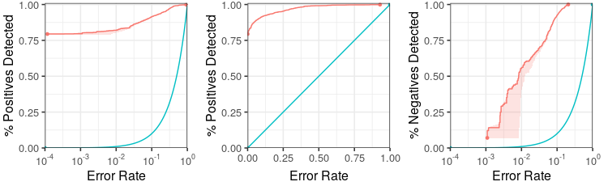
Models Evaluated using ROC curves
Models evaluated in a leave-one-pig-out cross validation framework.
Random forest models trained (Auton Lab variant).
Handles missing values.
Builds explainable models.
Supports non-linear decision boundaries.
Successfully used in many other similar projects.
Performance compared using receiver operator characteristic (ROC) curves.
Training Set
Testing Set
Positive class: Bleeding
Negative class: Not-bleeding
Notes:
We will use receiver operator characteristic curves (or ROCs) to present the performance of the models, so it is important that you understand what they're showing you.
The ROC you see here a curve showing the tradeoff between a classifier's sensitivity (here labeled % positives detected, how often we correctly identify our positive class as positive) versus our false alarm rate (here marked simply error rate, how often we incorrectly classify the negative class as positive).
Operationally we're interested in model performance at low error rates, which we can't see very well on the linear plot in the middle...

Slide 10
Models Evaluated using ROC curves
Models evaluated in a leave-one-pig-out cross validation framework.
Random forest models trained (Auton Lab variant).
Handles missing values.
Builds explainable models.
Supports non-linear decision boundaries.
Successfully used in many other similar projects.
Performance compared using receiver operator characteristic (ROC) curves.
Training Set
Testing Set
Positive class: Bleeding
Negative class: Not-bleeding
Notes:
...so we can put the error rate on the log scale to zoom in to the lower values.

Slide 11
Models Evaluated using ROC curves
Models evaluated in a leave-one-pig-out cross validation framework.
Random forest models trained (Auton Lab variant).
Handles missing values.
Builds explainable models.
Supports non-linear decision boundaries.
Successfully used in many other similar projects.
Performance compared using receiver operator characteristic (ROC) curves.
Training Set
Testing Set
Positive class: Bleeding
Negative class: Not-bleeding
Notes:
And since we're interested in low miss rates as well we can plot that on the log scale, again zooming in to the low values.
In fact, we really don’t care much about the linear plot at all since most of the plot shows unrealistic operating conditions: those with unacceptably high alarm rates.

Slide 12
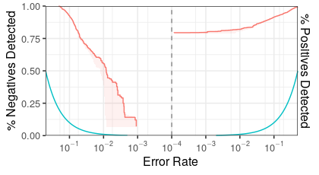
Models Evaluated using ROCOR curves
Models evaluated in a leave-one-pig-out cross validation framework.
Random forest models trained (Auton Lab variant).
Handles missing values.
Builds explainable models.
Supports non-linear decision boundaries.
Successfully used in many other similar projects.
Performance compared using receiver operator characteristic (ROC) curves. ROCOR variant
Training Set
Testing Set
Combined to form ROCOR
Positive class: Bleeding
Negative class: Not-bleeding
Notes:
So we can cut out the middle man (literally) and combine the two plots together to form what we call the ROCOR plot. We orient them so the low error rates are focused in the middle, and so negative predictive performance is on the left (somewhat corresponding to the negative direction of a number line) and positive predictive performance is on the right. Better performance is indicated by higher curves above the bowl shape formed by the random model (the blue line).

Slide 13
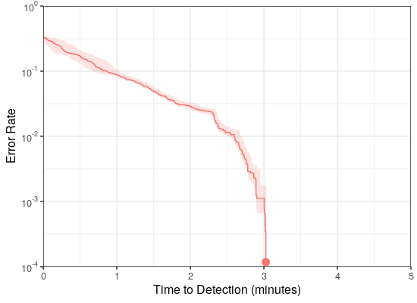
Models also Evaluated using AMOC curves
Models evaluated in a leave-one-pig-out cross validation framework.
Random forest models trained (Auton Lab variant).
Handles missing values.
Builds explainable models.
Supports non-linear decision boundaries.
Successfully used in many other similar projects.
We’ll also use Activity Monitoring Operator Characteristic (AMOC) curves to present detection latency.
Training Set
Testing Set
Latency of 3 minutes at error rate of 1/1000
Notes:
Another plot that will be used to compare models is the Activity Monitoring Operator Characteristic curve, the AMOC. It’s presented similarly to the ROC described, which includes showing the error rate on the log scale to zoom into the interesting region, but the difference here is we’re no longer talking about prediction performance (how many classifications can we make correctly for some fixed error rate), but instead this plot attempts to compare detection latency: how much time elapses after the bleed starts before the model can correctly detect it. This latency will depend on the operating point, which also sets the error rate: if the detector is very sensitive, it can detect quickly but it will throw more false alarms; if the detector is less sensitive, the detections will take longer but there won’t be as many false alarms. This plot shows that tradeoff.

Slide 14
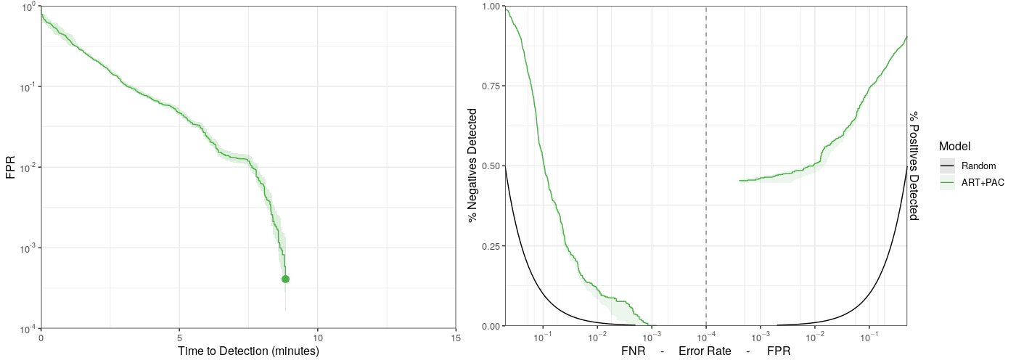
Performance with All Sensors and Universal Baseline
As shown (Wertz et al., 2019) performance without individual baselines but with all sensing modalities at highest granularity (waveform) performs well.
AMOC
ROCOR
50% detection of bleed
@ 1/100 error rate
1/100 false alarm rate
12% correct identification of non-bleeding
@ 1/100 error rate
7.5 minute latency
Notes:
Here is a look at our previous results. Using all sensing modalities, with full waveform data available, we can detect bleed reasonably well, within about 7 and a half minutes, while making few errors (1 in 100). We see this on the AMOC to the left. The ROCOR on the right gives an idea of some of the trouble we see without individual baselines: bleeding is easy to characterize (the pigs all trend toward a similar state, we see this on the right side of the plot) but the non-bleeding period is much more difficult (as shown on the left side, the pigs’ individual physiologies are different enough to make characterizing them difficult for the model). However, with enough sensors and data granularity we’re able to detect well despite this challenge.

Slide 15
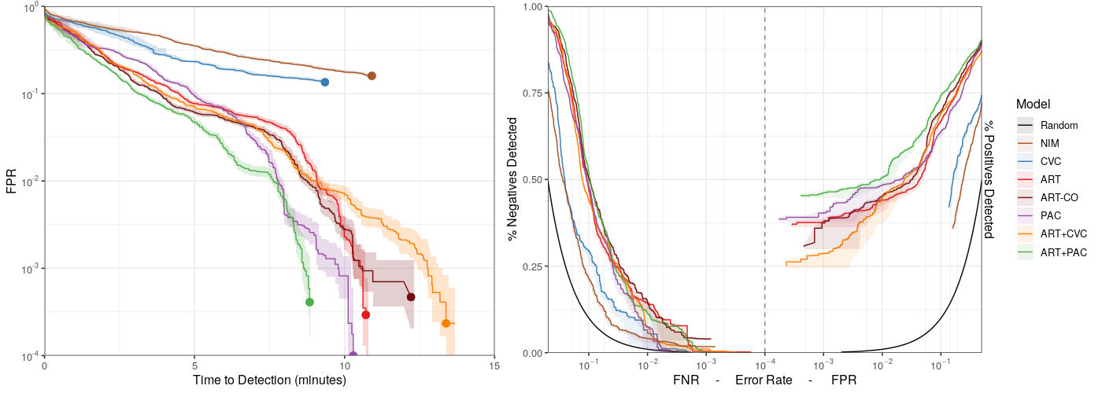
Performance with Universal Baseline and Waveform Data
Performance degrades (longer latencies, higher error rates, lower detection rates) as sensors are removed.
AMOC
ROCOR
Worse Performance
CVC performs poorly, even with waveform
Notes:
When we reduce the availability of invasive sensing modalities, we see (as expected) the detection performance is degraded. Non-invasive and CVC modalities are not useful for detecting bleed, even at the waveform granularity. If a PAC or ART line is available, bleeding performance is still good.

Slide 16
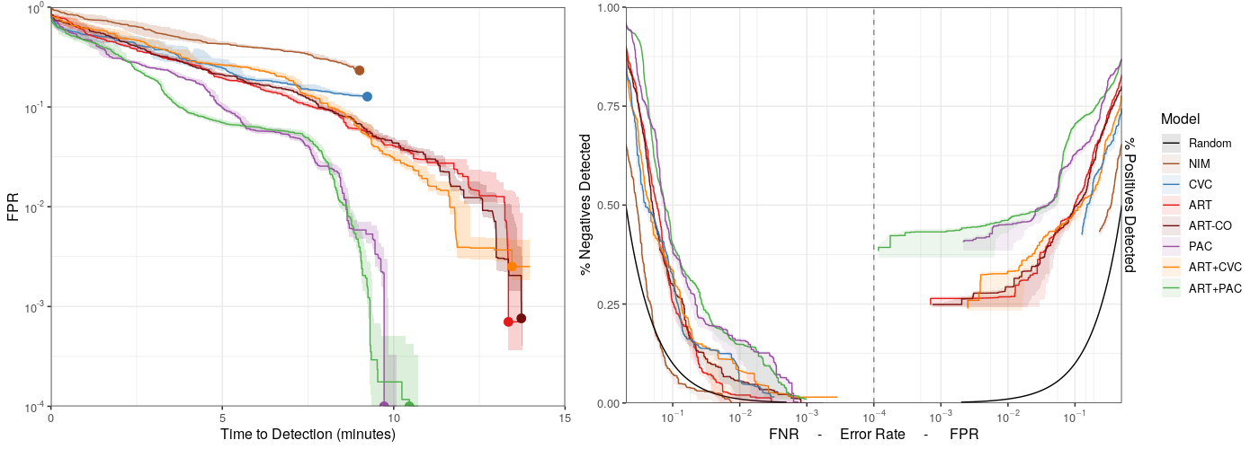
Performance with Universal Baseline and Beat-to-Beat Data
Performance degrades further when granularity is reduced to beat-to-beat.
AMOC
ROCOR
At B2B, only models with PAC maintain performance
Notes:
After reducing to the beat-to-beat granularity, all models except those incorporating the pulmonary artery catheter degrade significantly in performance. It’s interesting to note that, without individual baselines, a PAC provides the most discriminatory power.

Slide 17
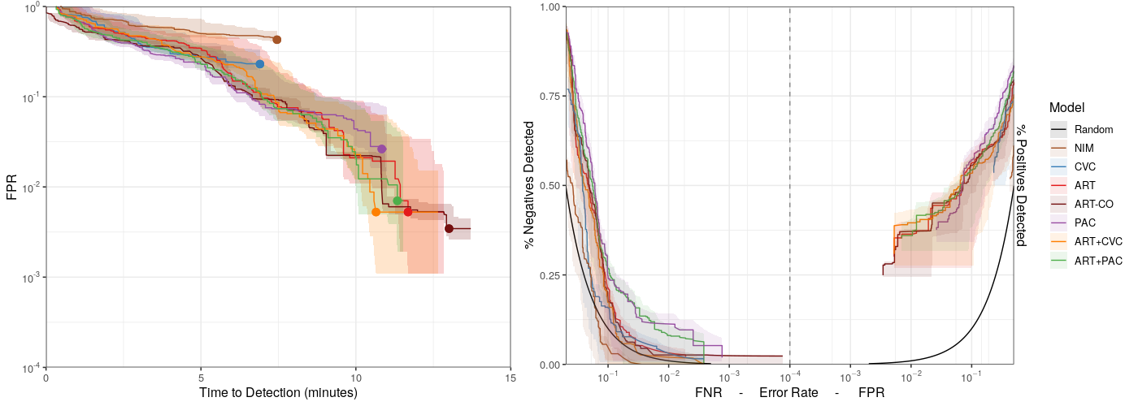
Performance with Universal Baseline and Simple Metrics
And finally when data is available only intermittently, allowing the use of only simple metrics in the models.
AMOC
ROCOR
Might still be usable if higher error rates are acceptable
Notes:
And at the intermittent level, where only simple metrics can be derived due to the limited data availability, performance for all models degrades, and the variance of the predictions is much larger. Interestingly, there is still some predictive value for the invasive measurements other than CVC, so long as the clinical scenario can tolerate a higher alarm rate and a time to detection greater than ten minutes.

Slide 18
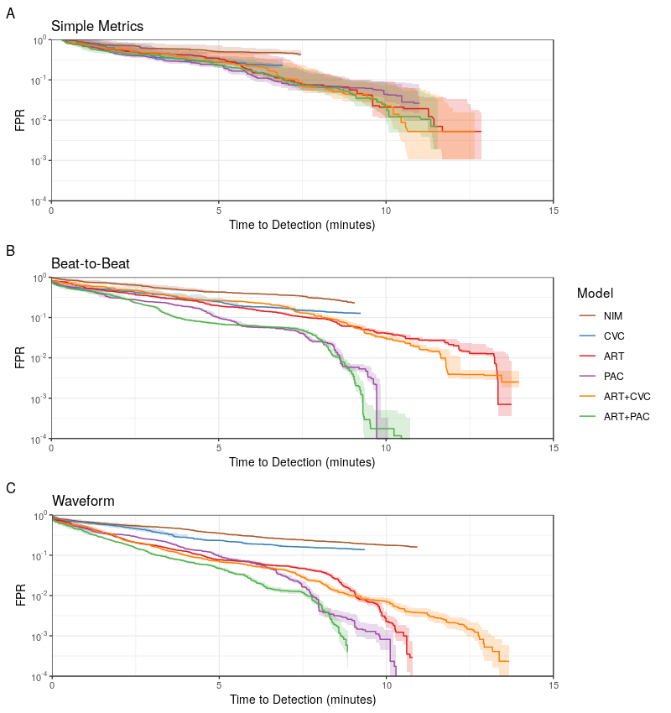
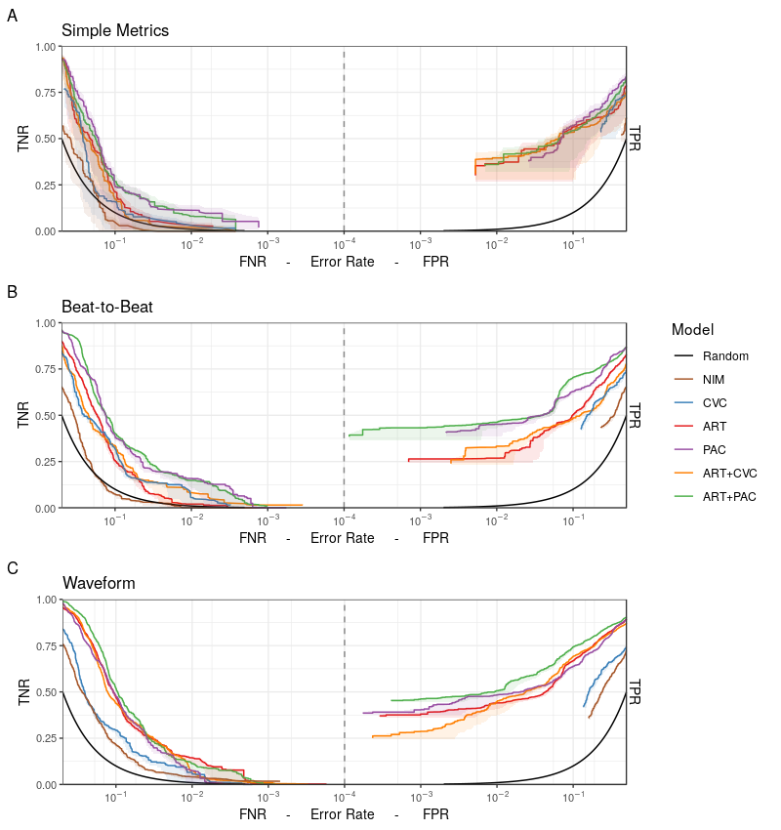
Performance with Universal Baseline
Key Finding: Detection of hemorrhage is possible without individual baselines for all modalities except non-invasive and CVC.
AMOC
ROCOR
Notes:
We note that detection of hemorrhage without individual baselines is possible only with invasive measurements, excluding CVC where the signal is still too noisy.

Slide 19
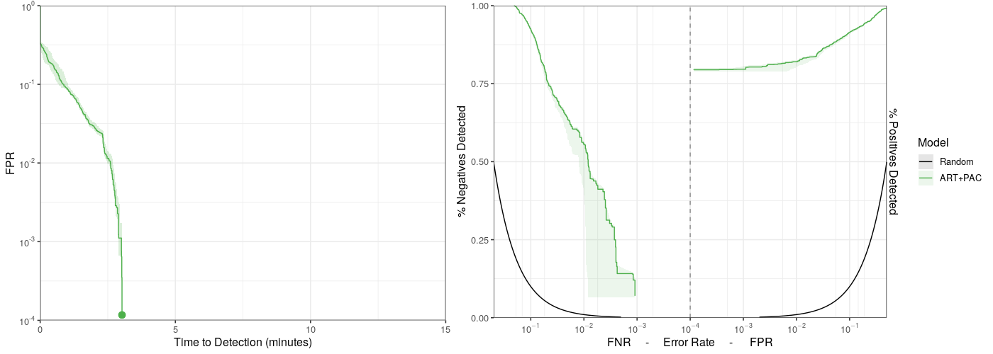
Performance with All Sensors and Individual Baseline
As shown (Wertz et al., 2019) performance with individual baselines and with all sensing modalities at highest granularity (waveform) performs very well.
AMOC
ROCOR
82% detection of bleed
@ 1/100 error rate
1/100 false alarm rate
56% correct identification of non-bleeding
@ 1/100 error rate
2.5 minute latency
Notes:
Again, looking at previous results, with the incorporation of individual baselines the detection performance is greatly improved. Predictive performance is greatly improved, in particular of the baseline state as the normalization compensates for the variability of normal physiology across pigs.

Slide 20
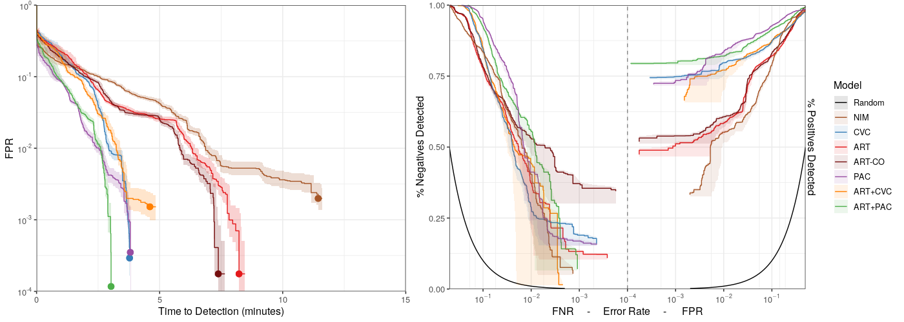
Performance with Individual Baseline and Waveform Data
Performance degrades (longer latencies, higher error rates, lower detection rates) as sensors are removed. Interesting, CVC now performs very well.
AMOC
ROCOR
CVC performs very well
Non-invasive perform well with waveform data
ART alone is not as good as CVC or PAC alone
Notes:
Again, when removing sensing modalities, this performance degrades. However, it’s interesting to note that, while CVC provided no predictive power without normalization, with an individual baseline it becomes a top performer. It’s also interesting to note that detection is possible with non-invasive sensing alone, although with a substantial increase in latency compared with invasive measures. Finally, the arterial catheter alone is not as informative as PAC or CVC.

Slide 21
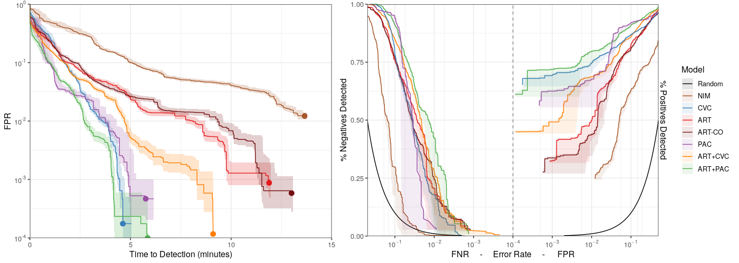
Performance with Individual Baseline and Beat-to-Beat Data
Performance degrades further when granularity is reduced to beat-to-beat.
AMOC
ROCOR
CVC still performs very well at B2B granularity
Notes:
Moving to beat-to-beat granularity, performance degrades somewhat, but the models still detect with low latency. CVC is still among the top.

Slide 22
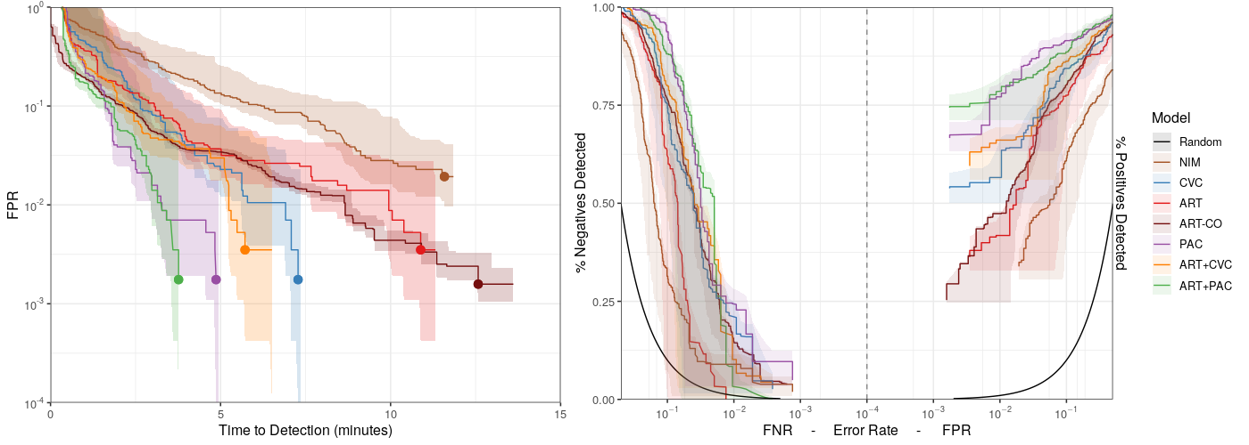
Performance with Individual Baseline and Simple Metrics
And finally when data is available only intermittently, allowing the use of only simple metrics in the models.
AMOC
ROCOR
Performance is still good with minimal data granularity
Notes:
Finally, at the level of simple metrics, low alarm rates are more difficult to achieve, but detection latency is maintained in the presence of PAC. At this point CVC begins to degrade in utility, but it’s still superior to ART alone.

Slide 23
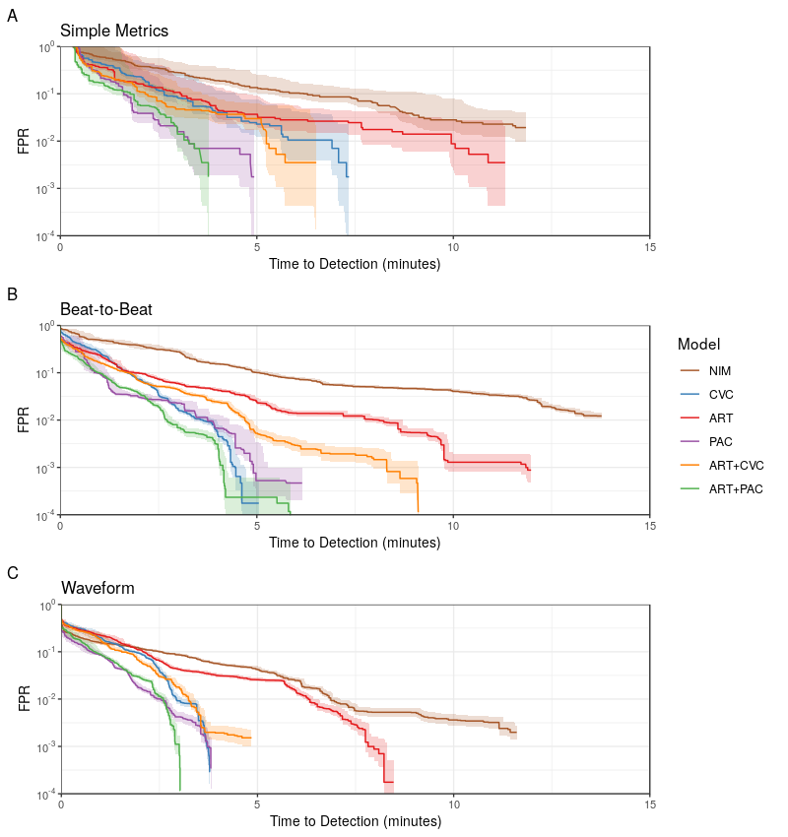
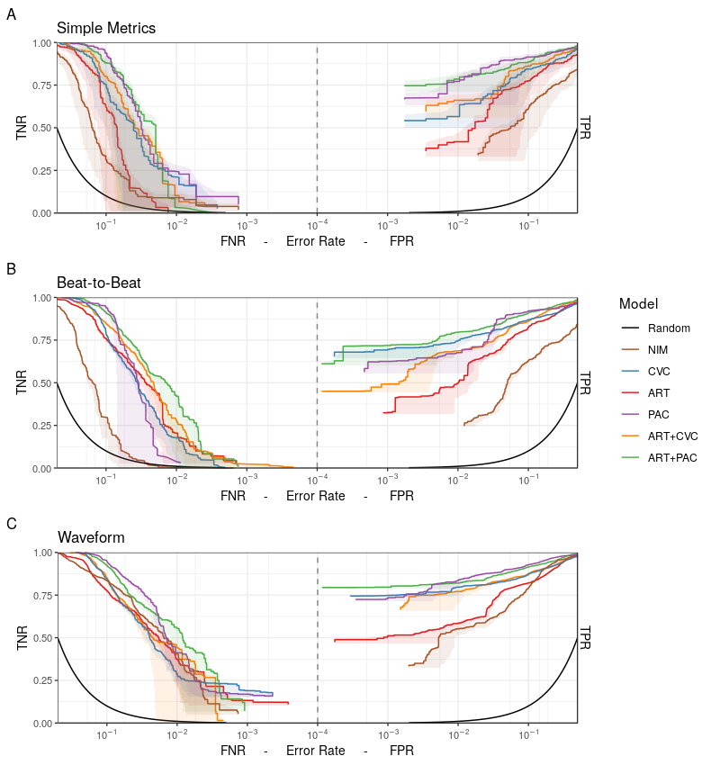
CVC Performs Well with an Individual Baseline
Key Finding: With baseline, CVC is a top performing model and detects well at all data granularities
AMOC
ROCOR
Notes:
We note that, when considering individual baselines, CVC becomes a top performer, where it was previously unable to detect hemorrhage at all.

Slide 24
Non-Invasive Can Be Used to Predict Bleed
Key Finding: With baseline, CVC is a top performing model and detects well at all data granularities
AMOC
ROCOR
Key Finding: Non-invasive modalities can be used to detect bleed if an individual baseline is available and data is at the waveform granularity.
Notes:
Further, even non-invasive modalities can detect hemorrhage if an individual baseline is available at waveform granularity.

Slide 25
Rapid Bleed Detection is Possible with Less Rich Modalities
Key Findings
Detection of hemorrhage is possible without individual baselines for all modalities except non-invasive and CVC.
With baseline, CVC is a top performing model and detects well at all data granularities
Non-invasive modalities can be used to detect bleed if an individual baseline is available and data is at the waveform granularity.
Impact (why we care)
Next Steps
The analysis is applicable to a wider range of clinical scenarios which may lack high data granularity, individual baselines, or specific sensing modalities.
The tradeoffs can be more clearly understood and determined based on the specific needs of the clinician.
How well is hemorrhage distinguished from other problems (e.g., hypovolemia due to sepsis)?
How well do these results translate outside of the controlled lab environment and on to human subjects?
Notes:
To conclude, we've shown that detection of hemorrhage is possible without baselines for all modalities except CVC and non-invasive; that, with individual baselines, CVC is a top performer; and that non-invasive sensing can be used when baselines and waveform data are available.
This work is important because it demonstrates the tradeoffs made in different clinical scenarios where different sensing modalities are available. This work allows for the identification of the appropriate operational configurations for the specific clinical use-case.
Thank you.

